Slide 1
UPPER SIXTH ARTS
GEOGRAPHY
Lesson 10
Impacts of Agriculture on the Environment
Notes:
Good morning, class, and welcome to our geography lesson. I am your geography teacher, Mr Kamdem. Today we are starting Lesson 10: Impacts of Agriculture on the Environment.

Slide 2
CLASS INFO
Class, Chapter and Duration
Class | Upper Sixth Arts
Chapter | Module 6: Understanding and managing the dynamics of economic activities across the world in general and Cameroon in particular
Duration | 2 periods (2 × 50 minutes)
Notes:
This lesson is for Upper Sixth Arts. It belongs to Module 6: Understanding and managing the dynamics of economic activities across the world in general and Cameroon in particular. We shall need 2 periods to cover it.

Slide 3
IDENTIFICATION
Lesson Identification
Topic | Developments in Agriculture
Sub-topic | Agriculture and the Environment
Lesson | Lesson 10: Impacts of Agriculture on the Environment
Notions / Concepts | Deforestation, soil erosion, pollution, eutrophication, organic farming.
Syllabus focus | Negative and positive impacts; organic farming: meaning, methods, advantages and disadvantages.
Competence | Learners are able to explain the impacts of agriculture on the environment and assess organic farming.
Notes:
Our topic is Developments in Agriculture, and the sub-topic is Agriculture and the Environment. The key notions we shall use today are: deforestation, soil erosion, pollution, eutrophication, organic farming. At the end, you should be able to do this: learners are able to explain the impacts of agriculture on the environment and assess organic farming.

Slide 4

HOMEWORK CORRECTION
Correction of the Homework
Question (Lesson 9: Meeting the Increasing Food Demand):
Suggest three measures to reduce food shortage in the Far North.
Notes:
Before we start the new lesson, let us correct the homework I gave you at the end of Lesson 9: Meeting the Increasing Food Demand. The question was: Suggest three measures to reduce food shortage in the Far North. Take out your exercise books.

Slide 5
HOMEWORK CORRECTION
Correction: Possible Answer
Measures for the Far North: irrigation from the Logone and dams, drought-resistant seeds, storage facilities (granaries) to avoid losses, and better roads to markets.
Notes:
Here is a good answer. Measures for the Far North: irrigation from the Logone and dams, drought-resistant seeds, storage facilities (granaries) to avoid losses, and better roads to markets. Compare it with your own answer and correct your work in red.

Slide 6
LESSON PLAN
Lesson Plan
Correction of the homework
Objectives and recall
Real-life situation and action to take
Learning activities
Board summary
Evaluation, remediation and homework
Notes:
Here is the plan of our lesson today. First, we shall correct the homework. Then we shall look at the objectives and recall what you already know. After that, we shall study a situation from real life and the action to take, and do the learning activities. Finally, we shall copy the board summary, do the evaluation and the remediation, and I will give you the homework.

Slide 7
OBJECTIVES
Objectives
By the end of this lesson, you should be able to:
Explain the negative impacts of agriculture.
Explain the positive impacts.
Explain organic farming and assess it.
Notes:
By the end of this lesson, you should be able to do three things. Number 1: explain the negative impacts of agriculture. Number 2: explain the positive impacts. Number 3: explain organic farming and assess it.

Slide 8
PREVIOUS KNOWLEDGE
Previous Knowledge
Clearing forests increases erosion.
Fertilisers can pollute rivers.
Notes:
Let us first remember what you already know. Clearing forests increases erosion. Fertilisers can pollute rivers. Keep this in mind, because we shall build on it today.

Slide 9
REAL-LIFE SITUATION
Situation in Real Life
Around Garoua, farmers burn the bush each year before planting, and rivers are polluted by fertiliser. A cooperative near Dschang sells vegetables grown without chemicals at a higher price.
Notes:
Listen carefully to this situation from real life. Around Garoua, farmers burn the bush each year before planting, and rivers are polluted by fertiliser. A cooperative near Dschang sells vegetables grown without chemicals at a higher price. Think about it, because I am going to ask you some questions.

Slide 10
REAL-LIFE SITUATION
Situation: Question 1
What is the problem in the situation?
Notes:
Question 1: What is the problem in the situation? Think for a moment, then raise your hand to answer.

Slide 11
REAL-LIFE SITUATION
Answer
Farming damages the environment.
Notes:
Good. Farming damages the environment.

Slide 12
REAL-LIFE SITUATION
Situation: Question 2
Give one negative impact.
Notes:
Question 2: Give one negative impact. Think for a moment, then raise your hand to answer.

Slide 13
REAL-LIFE SITUATION
Answer
Bush fires or pollution.
Notes:
Good. Bush fires or pollution.

Slide 14
REAL-LIFE SITUATION
Situation: Question 3
What is farming without chemicals called?
Notes:
Question 3: What is farming without chemicals called? Think for a moment, then raise your hand to answer.

Slide 15
REAL-LIFE SITUATION
Possible Answer
Organic farming.
Notes:
Good. Organic farming.

Slide 16
ACTION TO TAKE
Action to Take
Practise farming methods that protect the environment.
Notes:
From this situation, the action we are working towards in this lesson is the following: practise farming methods that protect the environment.

Slide 17
JUSTIFICATION
Justification of the Lesson
This lesson helps us to farm while protecting the environment.
Notes:
Why is this lesson important for you? This lesson helps us to farm while protecting the environment.

Slide 18

1. NEGATIVE IMPACTS
Activity 1
Land burnt before planting.
Notes:
Activity 1. Look carefully at this picture: land burnt before planting. Observe every detail before I ask the question.

Slide 19
1. NEGATIVE IMPACTS
Activity 1: Question
How do bush fires harm the environment?
Notes:
Here is the question for Activity 1: How do bush fires harm the environment? Take one minute to think and write your answer in your rough notebook.

Slide 20
1. NEGATIVE IMPACTS
Activity 1: Answer
They destroy vegetation and humus and expose soil to erosion.
Notes:
Let us check the answer together. They destroy vegetation and humus and expose soil to erosion.

Slide 21

1. NEGATIVE IMPACTS
Activity 2
Spraying chemicals.
Notes:
Activity 2. Look carefully at this picture: spraying chemicals. Observe every detail before I ask the question.

Slide 22
1. NEGATIVE IMPACTS
Activity 2: Question
How can farm chemicals harm rivers?
Notes:
Here is the question for Activity 2: How can farm chemicals harm rivers? Take one minute to think and write your answer in your rough notebook.

Slide 23
1. NEGATIVE IMPACTS
Activity 2: Answer
They wash into rivers, kill fish and cause algae growth (eutrophication).
Notes:
Let us check the answer together. They wash into rivers, kill fish and cause algae growth (eutrophication).

Slide 24

2. POSITIVE IMPACTS
Activity 3
Terraces.
Notes:
Activity 3. Look carefully at this picture: terraces. Observe every detail before I ask the question.

Slide 25
2. POSITIVE IMPACTS
Activity 3: Question
Give two positive impacts of farming.
Notes:
Here is the question for Activity 3: Give two positive impacts of farming. Take one minute to think and write your answer in your rough notebook.

Slide 26
2. POSITIVE IMPACTS
Activity 3: Answer
Terraces protect slopes; tree crops and agroforestry protect soils.
Notes:
Let us check the answer together. Terraces protect slopes; tree crops and agroforestry protect soils.

Slide 27
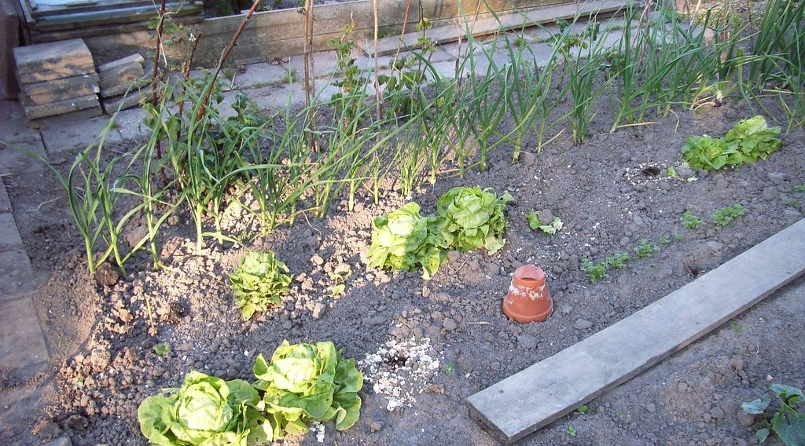
3. ORGANIC FARMING
Activity 4
A vegetable garden.
Notes:
Activity 4. Look carefully at this picture: a vegetable garden. Observe every detail before I ask the question.

Slide 28
3. ORGANIC FARMING
Activity 4: Question
What is organic farming?
Notes:
Here is the question for Activity 4: What is organic farming? Take one minute to think and write your answer in your rough notebook.

Slide 29
3. ORGANIC FARMING
Activity 4: Answer
Farming without chemical fertilisers or pesticides, using manure and natural methods.
Notes:
Let us check the answer together. Farming without chemical fertilisers or pesticides, using manure and natural methods.

Slide 30
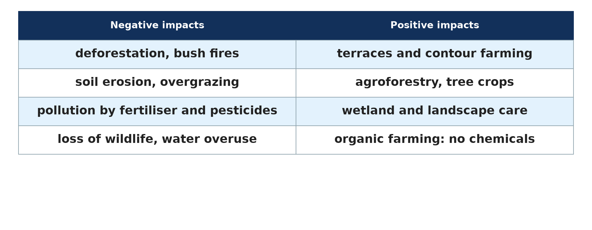
3. ORGANIC FARMING
Activity 5
Impacts of agriculture.
Notes:
Activity 5. Look carefully at this diagram: impacts of agriculture. Observe every detail before I ask the question.

Slide 31
3. ORGANIC FARMING
Activity 5: Question
Give one advantage and one disadvantage of organic farming.
Notes:
Here is the question for Activity 5: Give one advantage and one disadvantage of organic farming. Take one minute to think and write your answer in your rough notebook.

Slide 32
3. ORGANIC FARMING
Activity 5: Answer
Advantage: no pollution, healthy food. Disadvantage: lower yields and more labour.
Notes:
Let us check the answer together. Advantage: no pollution, healthy food. Disadvantage: lower yields and more labour.

Slide 33
BOARD SUMMARY
Board Summary
Topic: Developments in Agriculture
Sub-topic: Agriculture and the Environment
Lesson 10: Impacts of Agriculture on the Environment
Notes:
Now we are going to copy the board summary. Write the title and the headings neatly in your notebooks. I will give you enough time for each slide, so do not rush.

Slide 34
BOARD SUMMARY
1. Impacts of Agriculture on the Environment
Agriculture affects the environment both negatively and positively:
Negative impacts: Deforestation, bush fires, overgrazing and monoculture cause soil erosion and loss of biodiversity. Fertilisers and pesticides pollute rivers and cause eutrophication.
Notes:
Let us copy Impacts of Agriculture on the Environment. Agriculture affects the environment both negatively and positively. On this slide we have Negative impacts. Write each point on a new line, with the key term first, and explain it in your own words when we revise. When you finish, we go to the next slide.

Slide 35
BOARD SUMMARY
1. Impacts of Agriculture on the Environment (continued)
Other negative impacts: Irrigation can cause salinisation and falling water tables. Methane from cattle and rice fields adds to global warming.
Notes:
We continue with Impacts of Agriculture on the Environment. On this slide we have Other negative impacts. Write each point on a new line, with the key term first, and explain it in your own words when we revise. When you finish, we go to the next slide.

Slide 36
BOARD SUMMARY
1. Impacts of Agriculture on the Environment (continued)
Positive impacts: Terraces, agroforestry and hedges protect soils and create attractive landscapes. Well-managed farms store carbon and provide habitats.
Notes:
We continue with Impacts of Agriculture on the Environment. On this slide we have Positive impacts. Write each point on a new line, with the key term first, and explain it in your own words when we revise.

Slide 37
BOARD SUMMARY
1. Impacts of Agriculture on the Environment
Illustration: impacts of agriculture
Notes:
Now draw this illustration in your notebook: impacts of agriculture. Give it a title and label it clearly.

Slide 38
BOARD SUMMARY
2. Organic Farming
Organic farming can be studied as follows:
Meaning: It is farming without chemical fertilisers, pesticides or GM seeds. It relies on natural processes.
Notes:
Let us copy Organic Farming. Organic farming can be studied as follows. On this slide we have Meaning. Write each point on a new line, with the key term first, and explain it in your own words when we revise. When you finish, we go to the next slide.

Slide 39
BOARD SUMMARY
2. Organic Farming (continued)
Methods: Farmers use manure, compost, crop rotation, green manure and biological pest control. Mulching and intercropping protect the soil.
Notes:
We continue with Organic Farming. On this slide we have Methods. Write each point on a new line, with the key term first, and explain it in your own words when we revise. When you finish, we go to the next slide.

Slide 40
BOARD SUMMARY
2. Organic Farming (continued)
Advantages and disadvantages: It protects soils, water and health and gives higher prices for products. But yields are often lower and more labour is needed.
Notes:
We continue with Organic Farming. On this slide we have Advantages and disadvantages. Write each point on a new line, with the key term first, and explain it in your own words when we revise.

Slide 41
FORMATIVE EVALUATION
Evaluation 1
Give three negative impacts of agriculture.
Notes:
Now let us check what you have understood. Question 1: Give three negative impacts of agriculture. Answer in your exercise book.

Slide 42
FORMATIVE EVALUATION
Expected Answer
Deforestation, soil erosion, pollution (also salinisation).
Notes:
The expected answer is: deforestation, soil erosion, pollution (also salinisation). If you got it right, well done.

Slide 43
FORMATIVE EVALUATION
Evaluation 2
Give one advantage and one disadvantage of organic farming.
Notes:
Now let us check what you have understood. Question 2: Give one advantage and one disadvantage of organic farming. Answer in your exercise book.

Slide 44
FORMATIVE EVALUATION
Expected Answer
Advantage: less pollution. Disadvantage: lower yields.
Notes:
The expected answer is: advantage: less pollution. Disadvantage: lower yields. If you got it right, well done.

Slide 45
REMEDIATION
Remediation
Fill in the blanks:
Farming without chemicals is ______ farming.
Algae growth from fertilisers is ______.
Burning bush exposes soil to ______.
Notes:
For those who need more practice, fill in the blanks in your exercise book. The answers are: number 1, organic; number 2, eutrophication; number 3, erosion.

Slide 46
HOMEWORK
Homework
List farming practices in your area that harm or protect the environment.
Notes:
For your homework: List farming practices in your area that harm or protect the environment. We shall correct it at the beginning of our next lesson.

Slide 47
NEXT LESSON
Next Lesson
Our next lesson will be on:
Further Study 1: Agricultural Development and Change in Cameroon
Notes:
Our next lesson will be on Further Study 1: Agricultural Development and Change in Cameroon. Thank you for your attention, and see you next time.

Slide 48
BILINGUAL GAME
Bilingual Game (Jeu Bilingue)
English | Français
Environment | L'environnement
Organic farming | L'agriculture biologique
Pollution | La pollution
Manure | Le fumier
Erosion | L'érosion
Compost | Le compost
Notes:
Let us play the bilingual game. I say a word in English, and you give me the French word. Then we do the reverse.

Slide 49
LOGBOOK
Official Logbook (1/2)
Module / Topic | Developments in Agriculture
Lesson Title | Lesson 10: Impacts of Agriculture on the Environment
Expected Learning Outcomes | Explain the negative impacts of agriculture. Explain the positive impacts. Explain organic farming and assess it.
Competence | Learners are able to explain the impacts of agriculture on the environment and assess organic farming.
Notes:
I record this information in the official logbook of the class after the lesson.

Slide 50
LOGBOOK
Official Logbook (2/2)
Matter Taught | Impacts of Agriculture on the Environment; Organic Farming.
Evaluation | Formative evaluation and remediation exercise.
Homework | List farming practices in your area that harm or protect the environment.
Enrolment / Present / Absent | ____ / ____ / ____
Achievement | To be completed after the lesson.
Notes:
I complete the second page of the logbook: the matter taught, the evaluation, the homework and the attendance.

Slide 51
TEACHER'S NOTE
Teacher's Note
Timing: Homework correction, plan, objectives 8 min | Recall, situation, action 10 min | 5 activities 30 min | Board summary (copying) 30 min | Evaluation, remediation 10 min | Homework, next lesson 5 min | Logbook 7 min
Without the projector (Activity 1): discuss burning.
Without the projector (Activity 2): describe polluted water.
Without the projector (Activity 3): copy the table.
Without the projector (Activity 4): list organic methods.
Without the projector (Activity 5): discuss prices.
Notes:
This slide is for me, the teacher: it gives the timing of the lesson and what to do if the projector is not available.

Slide 52
REFERENCES
References
National Geography Syllabus, MINESEC/IGE/IP-SS, 2019 — Module 6 (Economic Geography).
Photo, Activity 1: “20111216-NRCS-LSC-0355” by USDAgov, CC BY 2.0, via Flickr (https://www.flickr.com/photos/41284017@N08/6551564351)
Photo, Activity 2: “k4817-4” by USDAgov, CC BY 2.0, via Flickr (https://www.flickr.com/photos/41284017@N08/8497812386)
Photo, Activity 3: “Terraced Hillside” by AdamCohn, CC BY-NC-ND 2.0, via Flickr (https://www.flickr.com/photos/96142515@N00/6311042523)
Photo, Activity 4: “Allotment garden” by tacowitte, CC BY 2.0, via Flickr (https://www.flickr.com/photos/31817492@N00/1509608412)
Diagrams and animations: drawn for this lesson (Geography Department).
Notes:
These are the references and picture credits used to prepare this lesson.

